Slide 1





15/11/2024
Sky's the Limit: A Personalized Flight Recommendation
Shivprasad Chaudhary
Shardul Gupta
Sumeet Pandit
Varsha Jain
Shreyas Badkar
A003
A033
A036
A046
A060
Mentored By:
Prof. Shraddha Sarode

Slide 2



Introduction
In today’s competitive airline industry, understanding and catering to individual customer preferences is essential for enhancing loyalty and satisfaction.
This project focuses on developing a sophisticated recommendation system that leverages sentiment analysis and predictive modeling to deliver tailored airline suggestions.
By analyzing customer feedback and predicting preferences, this system provides valuable insights into traveler needs and service expectations.
Designed to support both existing and new users, the solution empowers airlines to make data-driven improvements to their offerings, fostering a personalized experience that strengthens customer engagement and loyalty.

Slide 3






Problem Statement
The project aims to develop a recommendation system using sentiment analysis and predictive modeling to deliver tailored airline suggestions, enhancing customer satisfaction and supporting data driven decisions.

Slide 4







Objectives
Suggest new airlines to existing users and predict ratings based on user preferences.
Recommend airlines to new users based on their ratings.
Analyze user reviews to understand sentiment toward airlines and their services.

Slide 5
Literature Review
Content-based filtering personalizes airline recommendations by matching users with relevant features like class and services, as shown in hotel recommendation studies.
Sentiment analysis using machine learning and NLP helps airlines understand customer feedback, aiding in the prediction of customer preferences.
Real-time sentiment analysis from platforms allows airlines to quickly assess customer opinions using models like SVM and Naive Bayes.

Slide 6
Data Description
Variable
Description
Name
The name of the reviewer
Airline
The airline being reviewed
Reviews
The full text of the customer review
Type of Traveller
Specifies the type of traveler (e.g., Solo Leisure, Family Leisure)
Class
The travel class (e.g., Business Class, Economy)
Seat Comfort
A rating (out of 5) for seat comfort
Staff Service
A rating (out of 5) for the quality of staff service
Food & Beverage
A rating (out of 5) for food and beverage quality
Inflight Entertainment
A rating (out of 5) for inflight entertainment options
Value for Money
A rating (out of 5) for the value for money of the flight
Overall Rating
An overall rating score (out of 10) given by the reviewer
Recommended
Indicates whether the reviewer recommends the airline (yes or no)

Slide 7

METHODOLOGY
RECOMMENDATION

Slide 8



Content Based Filtering
1. Cosine Similarity:
Cosine Similarity is calculated as the cosine of the angle between two feature vectors, with values closer to 1 indicating high similarity between the item and the user profile, and values closer to 0 indicating low similarity.
In content-based filtering, cosine similarity is used to compare each airline's feature vector with a user’s preference profile, recommending the top 5 airlines with the highest similarity scores to best match the user's ratings.
2. Rating Prediction:
Estimate a user’s rating for an airline by comparing features of previously rated airlines with the features of new ones.
This can be done by taking a weighted average of similar airlines’ ratings, with weights determined by cosine similarity scores.
3. Handling a New User:
For the new user, it involves taking user-inputted ratings for five key features and creates a user profile.
Calculate cosine similarity between this profile and the existing airlines to recommend the most similar airline.
.

Slide 9
ANALYSIS & RESULTS
RECOMMENDATION

Slide 10
Recommendation Result
Top 5 Recommendation for Existing user
Recommendation for New User
A Ahmed | Singapore Airlines | Cathay Pacific Airways | All Nippon Airwais | Turkish Airline | Emirates
Seat Comfort | 3.7 | 3.6 | 4.1 | 2.7 | 3.2
Staff service | 4 | 3.6 | 4.5 | 2.9 | 3
Food & Beverages | 3.6 | 3.3 | 4.1 | 3 | 3
Inflight Entertainment | 3.9 | 3.8 | 3.9 | 3.1 | 3.7
Value For Money | 3.5 | 3.4 | 4.2 | 2.4 | 2.8
Name | New User
Seat Comfort | 4
Staff service | 4
Food & Beverages | 2
Inflight Entertainment | 2
Value For Money | 2
Recommendation | Emirates

Slide 11

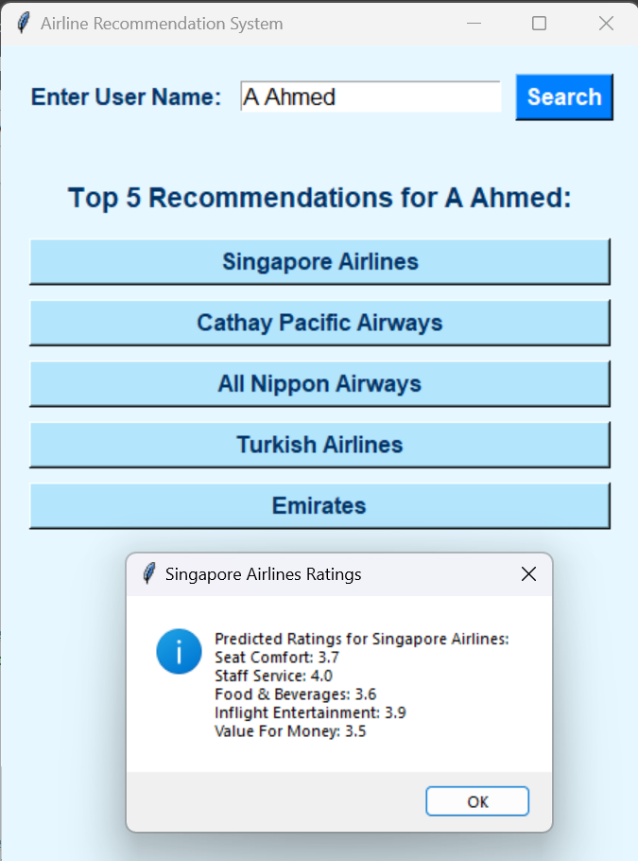
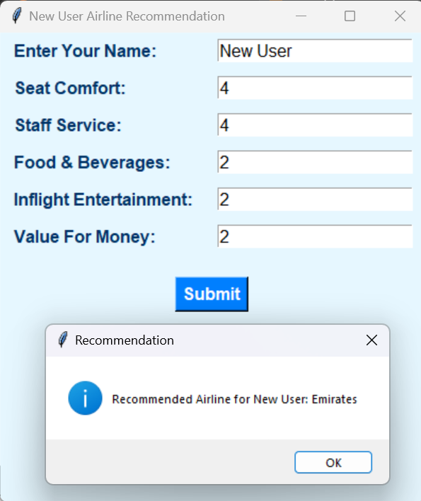

Recommendation GUI
Top 5 Recommendation for Existing user
Recommendation for New user

Slide 12
METHODOLOGY
NATURAL LANGUAGE PROCESSING

Slide 13










Preprocessing Steps
HTML Tags
URL
Slangs
Spell Correct
1.
2.
3.
4.
5.
LowerCasing
9.
8.
7.
6.
Stemming
Tokenization
Stopwords
Punctuation

Slide 14

Vectorization
Word Embedding
 | battle | horse | king | man
authority | 0 | 0.01 | 1 | 0.2
event | 1 | 0 | 0 | 0
has tail? | 0 | 1 | 0 | 0
rich | 0 | 0.1 | 1 | 0.3
gender | 0 | 1 | -1 | -1
In Natural Language processing, word embedding is the term used for the representation of words for text analysis typically in the form of real valued vector that encodes the meaning of the words such that the word that are closer in the vector space in the meaning.
Word2Vec
This model is based on the concept of word embeddings, which allow words with similar meanings to have similar representations in a high-dimensional space.

Slide 15
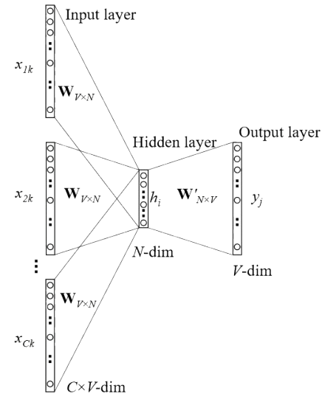

Vectorization
Continuous Bag-of-Words (CBOW)
The Continuous Bag of Words (CBOW) model is a Word2Vec approach that predicts a target word based on its surrounding context words within a window. It learns word embeddings by maximizing the probability of the target word given the context words.

Slide 16


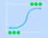



Text Classification
Logistic Regression
Random Forest
Gradient Boosting
AdaBoost
SVM
XGBoost

Slide 17
ANALYSIS & RESULTS
NATURAL LANGUAGE PROCESSING

Slide 18
Text Classification: Turkish Airlines
Model | Accuracy | Precision | Recall | F1-Score
Gradient Boosting | 0.913947 | 0.91336 | 0.913947 | 0.911912
AdaBoost | 0.893175 | 0.891682 | 0.893175 | 0.892087
SVM | 0.916914 | 0.916286 | 0.916914 | 0.915118
Logistic Regression | 0.910979 | 0.911005 | 0.910979 | 0.908311
Random Forest | 0.881306 | 0.879633 | 0.881306 | 0.877223
XGBoost | 0.905045 | 0.904161 | 0.905045 | 0.902603

Slide 19
Text Classification: Qatar Airways
Model | Accuracy | Precision | Recall | F1-Score
Gradient Boosting | 0.870769 | 0.868876 | 0.870769 | 0.864404
AdaBoost | 0.836923 | 0.830741 | 0.836923 | 0.830198
SVM | 0.843077 | 0.838361 | 0.843077 | 0.834018
Logistic Regression | 0.852308 | 0.848647 | 0.852308 | 0.844207
Random Forest | 0.858462 | 0.854599 | 0.858462 | 0.852254
XGBoost | 0.827692 | 0.820696 | 0.827692 | 0.821029

Slide 20
Text Classification: Comprehensive
Model | Accuracy | Precision | Recall | F1-Score
Gradient Boosting | 0.861728 | 0.863119 | 0.861728 | 0.861224
AdaBoost | 0.843827 | 0.844301 | 0.843827 | 0.843464
SVM | 0.884568 | 0.88472 | 0.884568 | 0.884432
Logistic Regression | 0.880247 | 0.880503 | 0.880247 | 0.880071
Random Forest | 0.848148 | 0.849195 | 0.848148 | 0.847645
XGBoost | 0.858025 | 0.858784 | 0.858025 | 0.857642

Slide 21

Conclusion
Content-based filtering successfully provides personalized airline suggestions by matching customer ratings across factors like seat comfort, staff service, etc ensuring tailored recommendations that align with individual preferences.
For Turkish Airlines, the SVM model performed the best with an accuracy of 91.7%, while for Qatar Airways, Gradient Boosting achieved the highest accuracy at 87.07%, indicating model performance varies by airline.
Overall, SVM consistently performed best with an accuracy of 88.5%, making it the most reliable model for general sentiment classification across airlines.

Slide 22
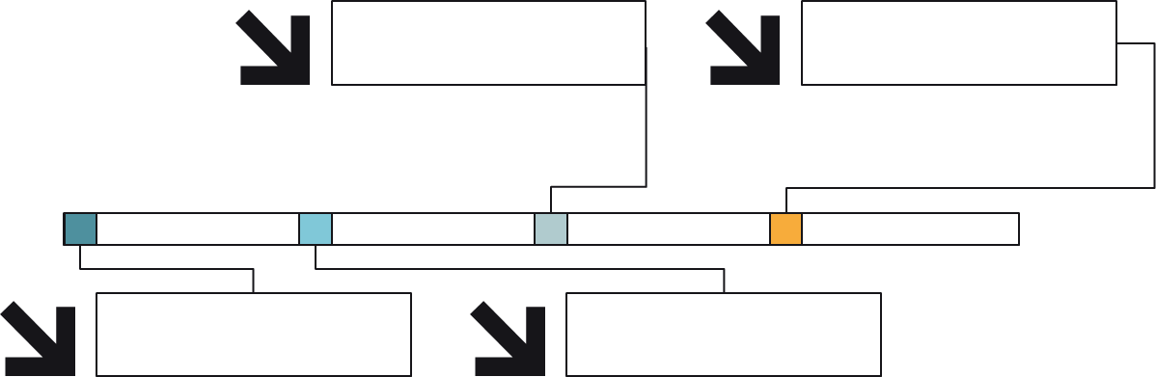
Limitations
Sentiment Analysis Challenges
Scalability and Efficiency
Content Based Filtering Challenge
Data Quality

Slide 23






Future Scope
Hybrid Recommendation Models
Real-Time Recommendations
Cross-Industry Applications
Advanced NLP Models

Slide 24

Bibliography
Melyani, Cheryl. (2022). Hotel Recommendation System with Content-Based Filtering Approach (Case Study: Hotel in Yogyakarta on Nusatrip Website). J Statistika: Jurnal Ilmiah Teori dan Aplikasi Statistika. 15. 10.36456/jstat.vol15.no1.a5375.
Alana, Reyhan & Hartanto, Adi. (2024). Implementation of Content Based Filtering Algorithm in Comic Recommendation System SISTEMASI. 13. 1344. 10.32520/stmsi.v13i4.2944.
Samir, Heba & Abd-Elmegid, Laila & Marie, Mohamed. (2023). Sentiment analysis model for Airline customers’ feedback using deep learning techniques International Journal of Engineering Business Management. 15. 10.1177/18479790231206019.
Chaurasia, Suhashini & Sherekar, Swati. (2023). Sentiment Analysis of Twitter Data by Natural Language Processing and Machine Learning 10.1007/978-981-99-2768-5_6.
Kannappan, Sindhura. (2023). SENTIMENT ANALYSIS USING NATURAL LANGUAGE PROCESSING AND MACHINE LEARNING Shu Ju Cai Ji Yu Chu Li/Journal of Data Acquisition and Processing. 38. 520-526. 10.5281/zenodo.7766376.

Slide 25

THANK YOU

